Slide 1
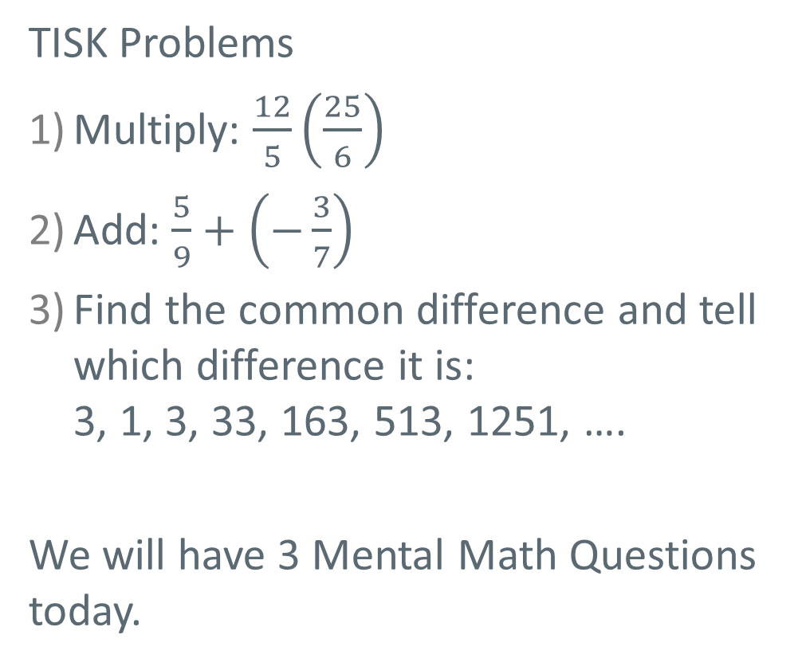
Wednesday, September 12, 2012
TISK Problems
Multiply: $\frac{12}{5}\left(\frac{25}{6}\right)$
Add: $\frac{5}{9}+\left(−\frac{3}{7}\right)$
Find the common difference and tell which difference it is:
3, 1, 3, 33, 163, 513, 1251, ….
We will have 3 Mental Math Questions today.
Homework: Complete the Percents Worksheet
Notes:
Mental Math
Start with the largest multiple of 3 that is less than 60. Divide by 3. Add 38. Subtract 7. Double it. (100)
Start with the largest multiple of 4 that is less than 80. Divide by 4. Add 48. Subtract 7. Double it. (120)
Start with the largest multiple of 6 that is less than 120. Divide by 6. Add 68. Subtract 7. Double it. (160)

Slide 2
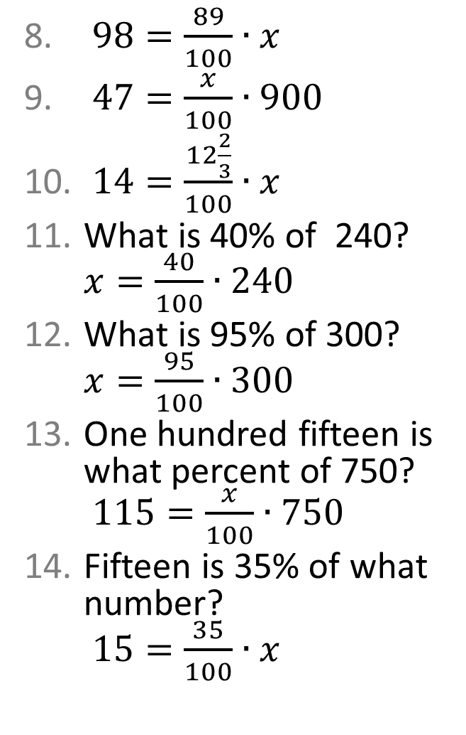
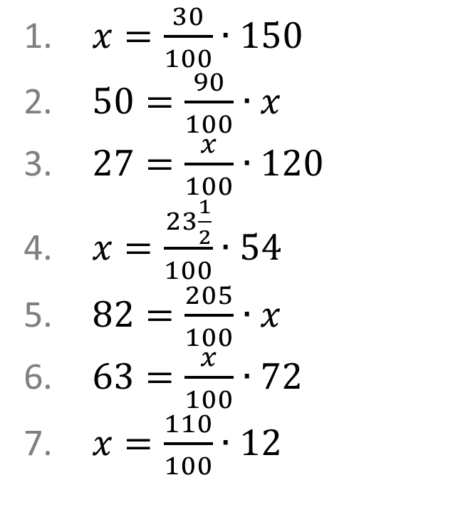
Homework Check
$98=\frac{89}{100}∙x$
$47=\frac{x}{100}∙900$
$14=\frac{12\frac{2}{3}}{100}∙x$
What is 40% of 240? $x=\frac{40}{100}∙240$
What is 95% of 300? $x=\frac{95}{100}∙300$
One hundred fifteen is what percent of 750?
$115=\frac{x}{100}∙750$
Fifteen is 35% of what number?
$15=\frac{35}{100}∙x$
$x=\frac{30}{100}∙150$
$50=\frac{90}{100}∙x$
$27=\frac{x}{100}∙120$
$x=\frac{23\frac{1}{2}}{100}∙54$
$82=\frac{205}{100}∙x$
$63=\frac{x}{100}∙72$
$x=\frac{110}{100}∙12$

Slide 3
Example 1. Solve a percent equation.
To solve a percent equation, set up two ratios.
To do this, divide by the number being multiplied.
Then, you can solve using one of two methods:
Using Equivalent Ratios…
Using Cross-Multiplication…

Slide 4
Example 2. Solve a percent equation.
Remember to check your original problem.
In this case, x was the missing percent.
Therefore, our final answer is 125%.

Slide 5
Example 3. Solve a percent equation.

Slide 6

Example 4. Solve a percent equation.
Our final answer is 5$\frac{5}{6}$%.

